Slide 1


Advance Stats I Project: Predict Customer Churn in the Telco Industry
Luke Philip Ogweno
Hong Shi

Slide 2



Goal of this project
This project aims to predict churn behaviors or not churn behaviors to help retain customers

Slide 3
Introduction
Customer retention is one of the primary growth pillars for products with a subscription-based business model.
Competition is tough in the SaaS market where customers are free to choose from plenty of providers even within one product category.
Several bad experiences – or even one – and a customer may quit.
When analyzing customer data from a company many interesting patterns can be observed and further analysis can lead to predictive models for various metrics.
Customer churn.
Monthly payments.
Usually, customers want to get quality service for the best possible price. If they don’t get it, they may choose another service provider.

Slide 4
What is customer churn?
Customer churn (or customer attrition) is the tendency of customers to abandon a brand and stop paying clients of a particular business.
The percentage of customers that discontinue using a company’s products or services during a particular time period is called a customer churn (attrition) rate.
Churn rate is a health indicator for businesses whose customers are subscribers and paying for services on a recurring basis, notes the head of the data analytics department at Science Soft Alex Bekker.

Slide 5
Case for customer churn prediction
Music and video streaming services
Media
Telecom companies (cable or wireless)
Software as a service providers

Slide 6
Music and video streaming services are probably the most commonly associated with the subscription business model (Netflix, YouTube, Apple Music, Google Play, Spotify, Hulu, Amazon Video, Deezer, etc.).
Media. Digital presence is a must among the press, so news companies offer readers digital subscriptions besides print ones (Bloomberg, The Guardian, Financial Times, The New York Times, Medium etc.).
Telecom companies (cable or wireless). These companies may provide a full range of products and services, including wireless network, internet, TV, cell phone, and home phone services (AT&T, Sprint, Verizon, Cox Communications, etc.). Some specialize in mobile telecommunications (China Mobile, Vodafone, T-Mobile, etc.).
Software as a service providers. The adoption of cloud-hosted software is growing. According to Gartner, the SaaS market remains the largest segment of the cloud market. Its revenue is expected to grow 17.8 percent and reach $85.1 billion in 2019. The product range of SaaS providers is extensive: graphic and video editing (Adobe Creative Cloud, Canva), accounting (Sage 50cloud, FreshBooks), eCommerce (BigCommerce, Shopify), email marketing (MailChimp, Zoho Campaigns), and many others.
These company types may use churn rate to measure the effectiveness of cross-department operations and product management.

Slide 7
Methodology
Understanding a problem and the final goal: In our case is the churn prediction
Data collection
Data preparation and preprocessing
Modeling and testing
Model deployment and monitoring

Slide 8
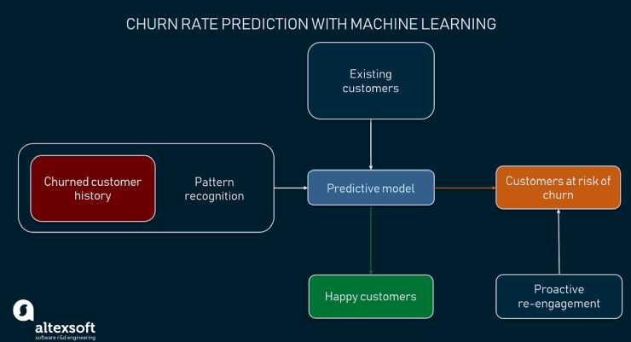
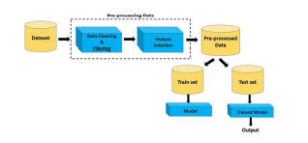
Churn rate predictive model
Exploratory Data Analysis

Slide 9
Statistical Learning Methods:
Decision tree
Random forest analysis
Logistic regression

Slide 10


Data Overview
The data was downloaded from IBM Sample Data Sets for customer retention programs. (IBM Sample Data Sets).
Each row represents a customer, each column contains a customer’s attribute.
Customers who left within the last month – the column is called Churn.
Services that each customer has signed up for – phone, multiple lines, internet, online security, online backup, device protection, tech support, and streaming TV and movies.
Customer account information – how long they’ve been a customer, contract, payment method, paperless billing, monthly charges, and total charges Demographic info about customers – gender, age range, and if they have partners and dependents.

Slide 11
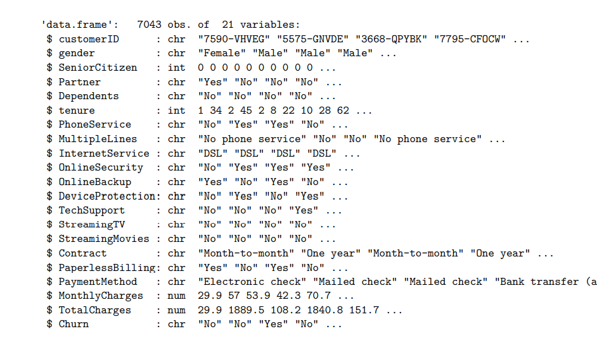
The raw data contains 7043 rows (customers) and 21 columns (features). The “Churn” column is our target. We used all other columns as features of our model.

Slide 12

Exploration and Data Analysis (EDA)

Slide 13
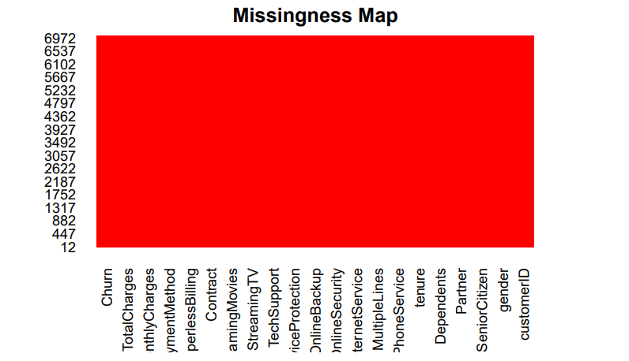
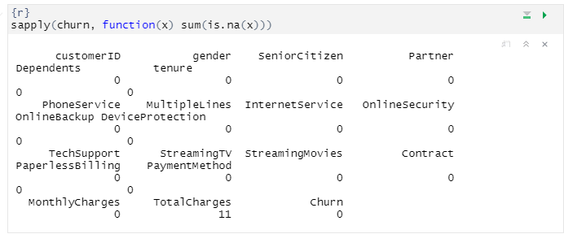
Missing values in each column
No missing data in this dataset!

Slide 14
Data wrangling
Changed “No internet service” to “No” for six columns, they are: “OnlineSecurity”,
“OnlineBackup”, “DeviceProtection”, “TechSupport”,
“streaming tv”,
“streaming movies”.
Change “No phone service” to “No” for column “multiple lines”.
Grouping Tenure: Since the minimum tenure is 1 month and maximum tenure is 72 months, we grouped them into five tenure groups:
“0–12 Months”,
“12–24 Months”,
“24–48 Months”,
“48–60 Month”,
“> 60 Month”.
. Changed the values in column “SeniorCitizen”
from 0 or 1 to “No” or “Yes”.
Removed the columns we do not need for the analysis.

Slide 15
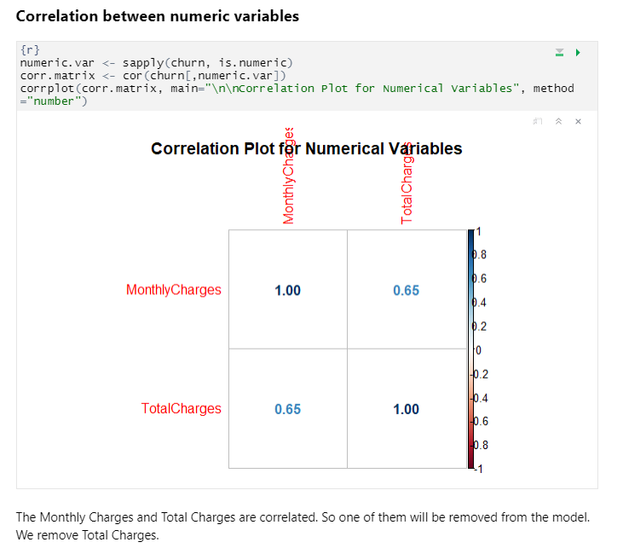
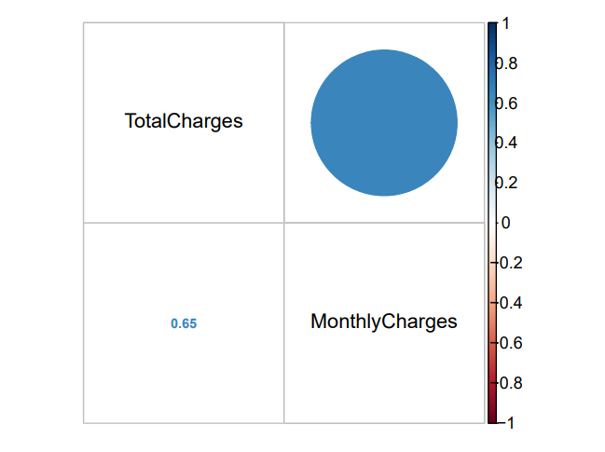
Exploratory data analysis and feature selection
The plot shows high correlations between Totalcharges and tenure and between TotalCharges and MonthlyCharges. Pay attention to these variables while training models later.
Multicollinearity does not reduce the predictive power or reliability of the model as a whole, at least within the sample data set. But it affects calculations regarding individual predictors.
The Monthly Charges and Total Charges are correlated. So, one of them will be removed from the model.
We removed TotalCharges.

Slide 16
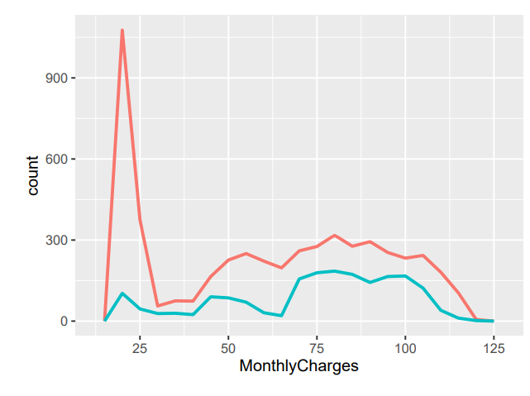
Continuous Variables
The number of current customers with MonthlyCharges below $25 is extremely high.
For the customers with Monthlycharges greater than $30, the distributions are similar between those who churned and who did not churn.
Notes:
The number of current customers with MonthlyCharges below $25 is extremely high. For the customers with Monthlycharges greater than $30, the distributions are similar between those who churned and who did not churn.

Slide 17
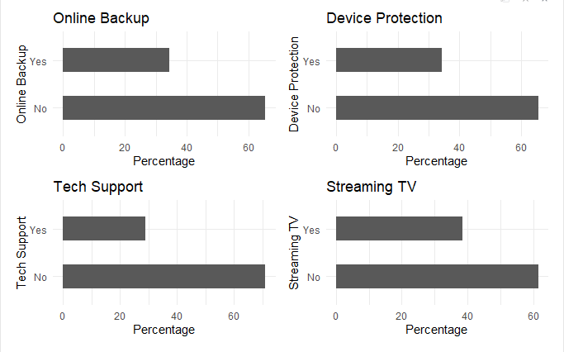
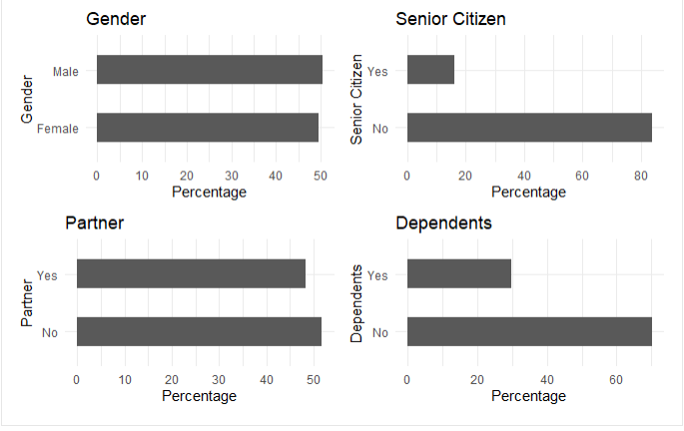
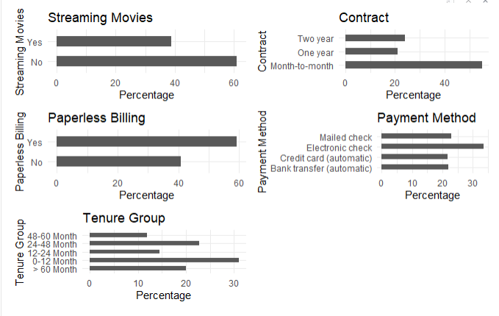
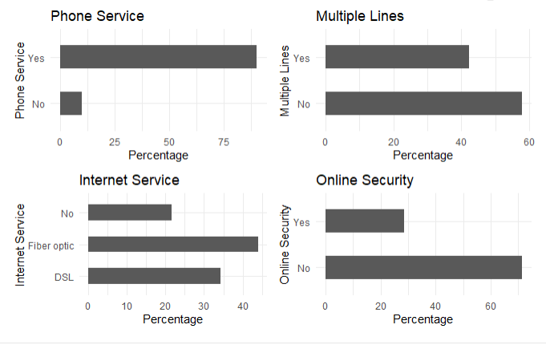
Bar plots of categorical variables
All the categorical variables seem to have a reasonably broad distribution, therefore, all of them will be kept for further analysis.
Notes:
All of the categorical variables seem to have a reasonably broad distribution, therefore, all of them will be kept for the further analysis.

Slide 18

Logistic Regression

Slide 19
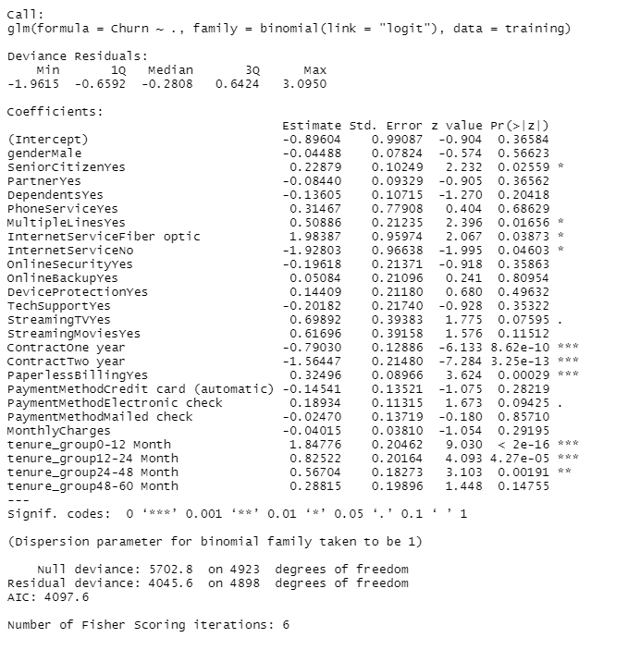
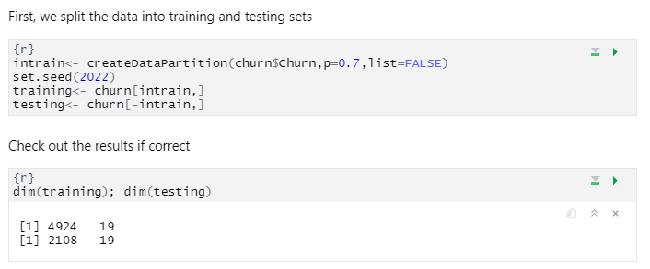
Logistic Regression

Slide 20
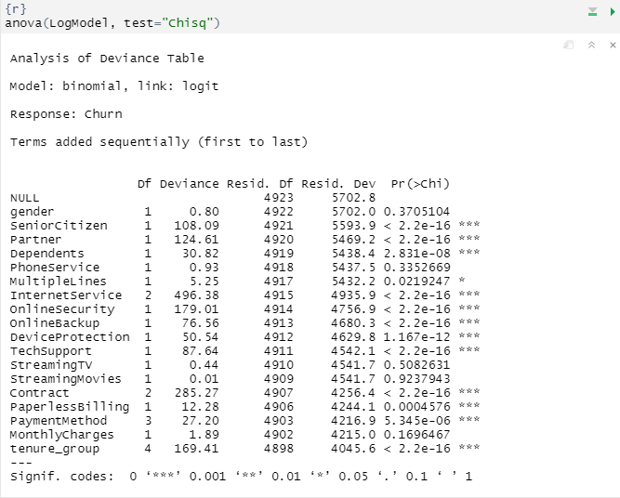
Feature Analysis
Analyzing the deviance table, we can see the drop in deviance when adding each variable one at a time.
Adding InternetService, Contract and tenure_group significantly reduces the residual deviance.
The other variables such as PaymentMethod and Dependents seem to improve the model less even though they all have low p-values.
Notes:
Analyzing the deviance table we can see the drop in deviance when adding each variable one at a time. Adding InternetService, Contract and tenure_group significantly reduces the residual deviance. The other variables such as PaymentMethod and Dependents seem to improve the model less even though they all have low p-values.

Slide 21
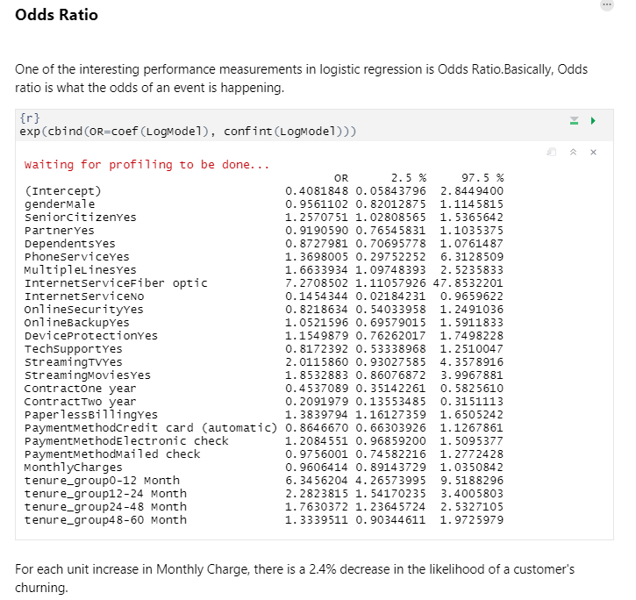
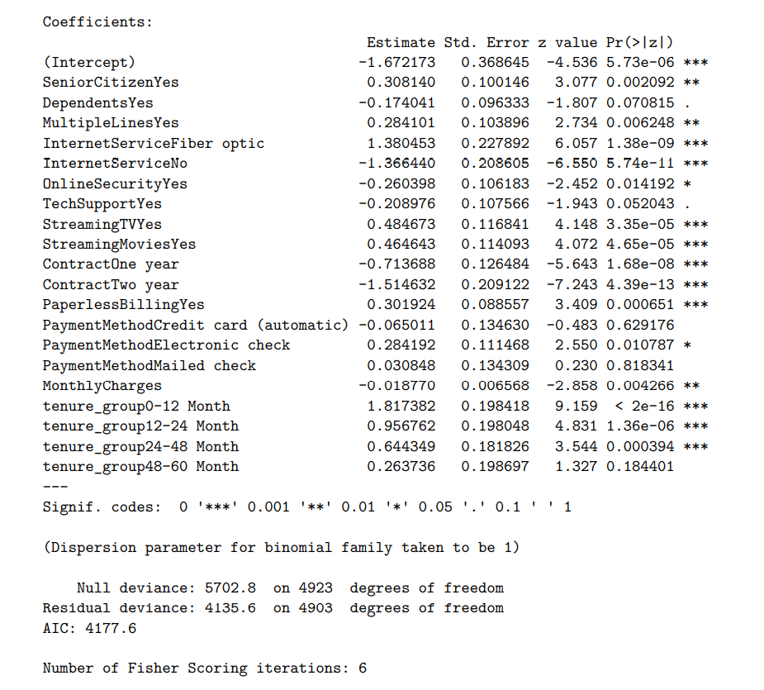
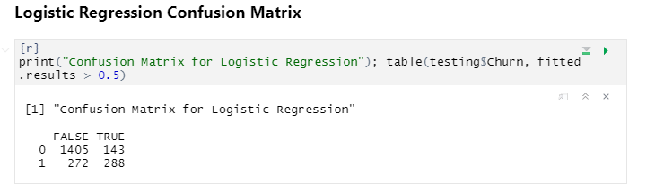
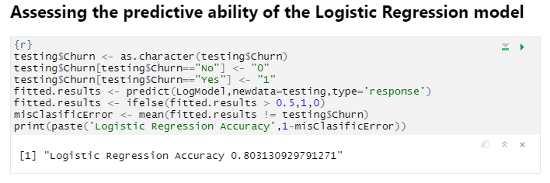
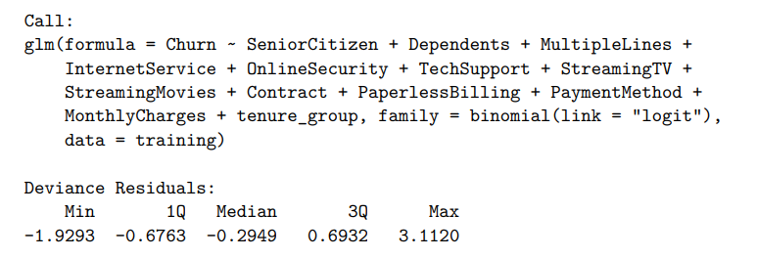

Slide 22
Decision Tree

Slide 23
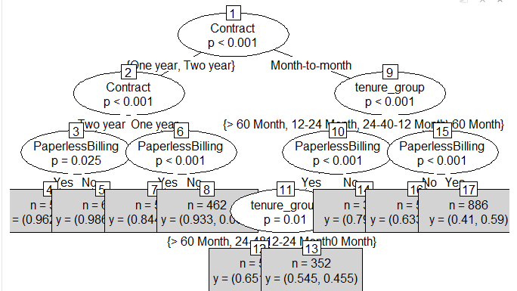

Slide 24
Grouping:
For illustration purposes, we are going to use only three variables, they are “Contract”, “tenure_group” and “PaperlessBilling”.
Conclusion:
Out of the three variables we use, Contract is the most important variable to predict customer churn or not churn.
If a customer is in a one-year or two-year contract, no matter whether he (she) has PapelessBilling or not, he (she) is less likely to churn.
On the other hand, if a customer is in a month-to-month contract, in the tenure group of 0–12 months, and using PaperlessBilling, then this customer is more likely to churn.

Slide 25
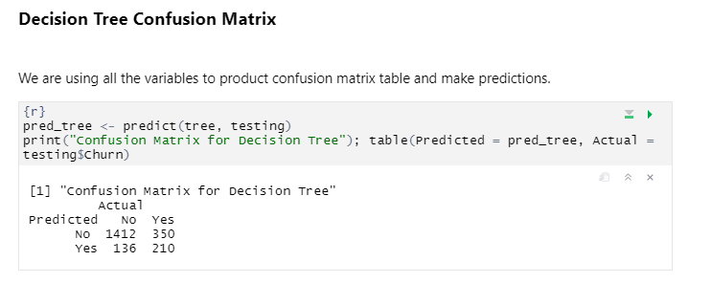
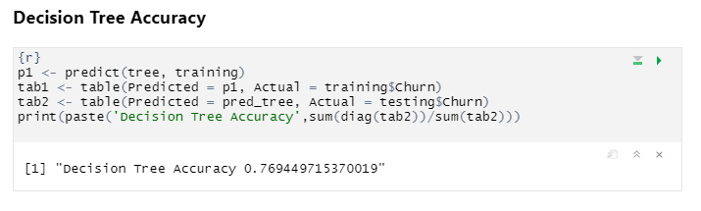
The accuracy of the Decision Tree has hardly improved. Let’s see if we can do better using Random Forest.

Slide 26

Random Forest

Slide 27
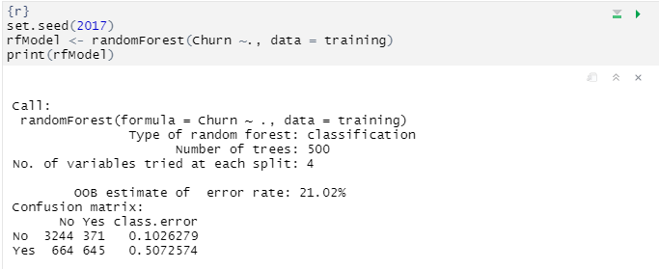
Random Forest Initial Model
The error rate is relatively low when predicting “No”, and
The error rate is much higher when predicting “Yes”.
Notes:
The error rate is relatively low when predicting “No”, and the error rate is much higher when predicting “Yes”.

Slide 28
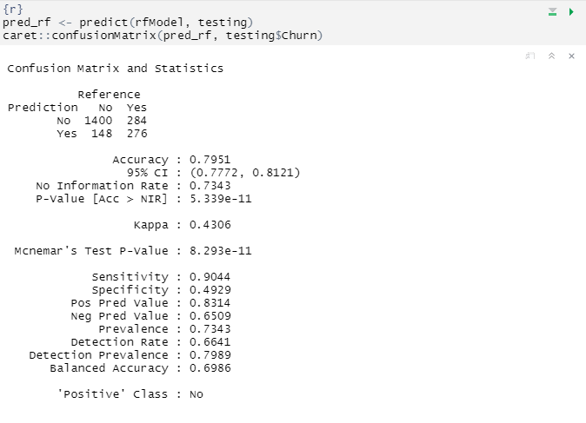
Random Forest Prediction and Confusion Matrix

Slide 29
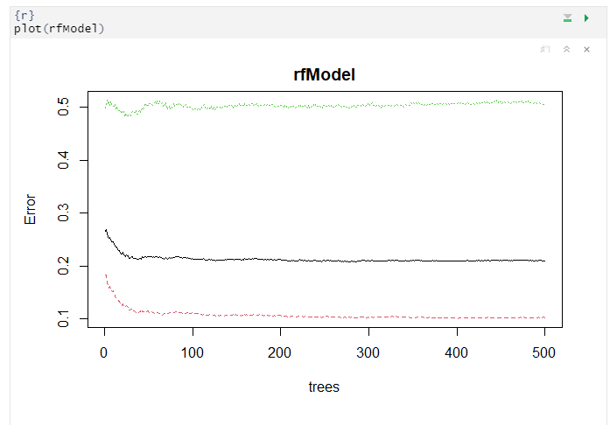
Random Forest Error Rate
We use this plot to help us determine the number of trees.
As the number of trees increases, the OOB error rate decreases and then becomes almost constant.
We are not able to decrease the OOB error rate after about 100 to 200 trees.
Notes:
We use this plot to help us determine the number of trees. As the number of trees increases, the OOB error rate decreases, and then becomes almost constant. We are not able to decrease the OOB error rate after about 100 to 200 trees.

Slide 30
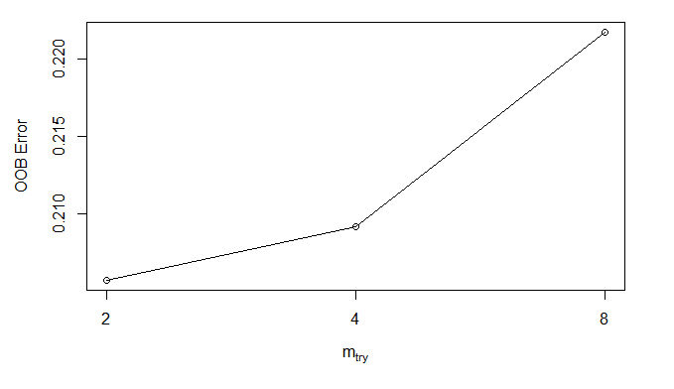
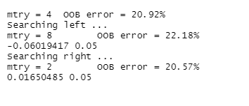
Tune Random Forest Model
We use this plot to give us some ideas on the number of mtry to choose.
OOB error rate is at its lowest when mtry is 2. Therefore, we choose mtry=2.
Notes:
We use this plot to give us some ideas on the number of mtry to choose. OOB error rate is at the lowest when mtry is 2. Therefore, we choose mtry=2.

Slide 31
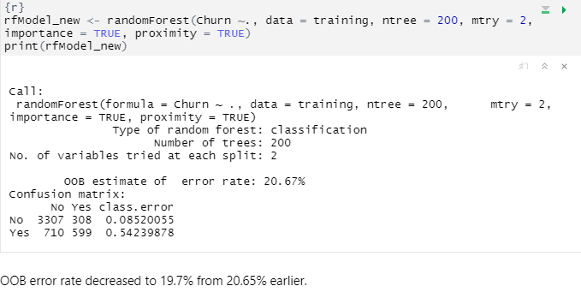
Fit the Random Forest Model After Tuning

Slide 32
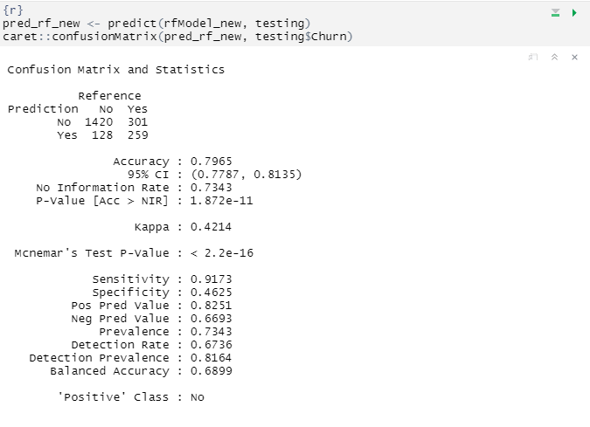
Random Forest Predictions and Confusion Matrix After Tuning
The accuracy and sensitivity improved, compared with the initial Random Forest model.
Notes:
The accuracy and sensitivity improved, compared with the initial Random Forest model.

Slide 33
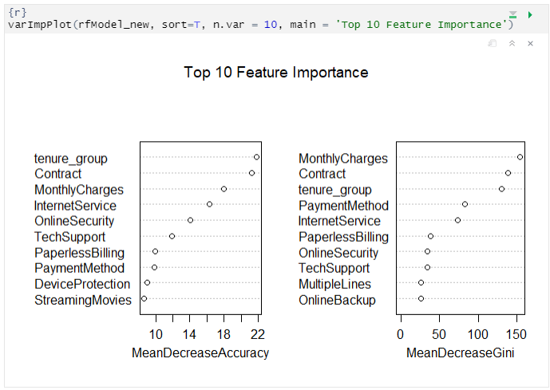
Random Forest Feature Importance

Slide 34
Summary
From the above example, we can see that Logistic Regression and Random Forest performed better than Decision Tree for customer churn analysis for this particular dataset.
Throughout the analysis, we have learned several important things:
Feature such as tenure_group, Contract, PaperlessBilling, MonthlyCharges, and internet service appears to play a role in customer churn.
There does not seem to be a relationship between gender and churn.
Customers in a month-to-month contract, with PaperlessBilling and are within 12 months of tenure, are more likely to churn;
On the other hand, customers with one or two-year contracts, with longer than 12 months tenure, that are not using PaperlessBilling, are less likely to churn.

Slide 35

Questions

